Slide 1
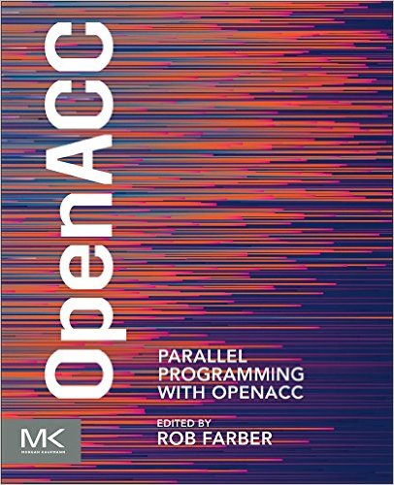
“It's all about Performance. One short sentence that sums up this book.”
Michael Wolfe (OpenACC Technical Committee Chair and PGI Compiler Engineer)
Key Features
Presents the simplest way to leverage GPUs to achieve application speedups
Shows how OpenACC works, including working examples that can be adapted for application needs
Allows readers to download source code and slides from the book's companion web page: https://github.com/rmfarber/ParallelProgrammingWithOpenACC
Draws on 23 authors from around the world
The book is about acquiring the knowledge to write practical and performant as well as portable parallel programs that can run across a broad spectrum of devices
Compilers: PGI, PathScale, Cray
Hardware: Intel x86 processors, Cavium 96-core 64-bit ARMv8 processor chipsets, and NVIDIA GPUs
“This book will become a valuable resource for scientists writing OpenACC applications because it includes real-world experiences and practical development strategies.”
Jeffrey S. Vetter (Oak Ridge National Laboratory)

Slide 2

Chapter 1: From Serial to Parallel Programming using OpenACC
Rob Farber (TechEnablement.com, USA)

Slide 3
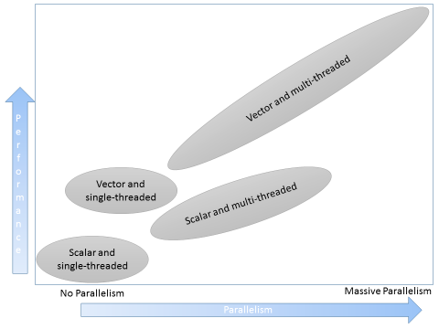
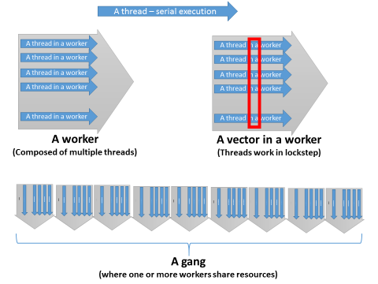
Chapter 1: Provide a basic understanding
How to create, build and run OpenACC applications.
Three rules of high-performance OpenACC programming.
The basic concepts of data-parallel and task-parallel programming.
An understanding of Big-O notation and Amdahl’s Law.
Race conditions, atomic operations, and how to avoid them.
The importance of lock-free programming.
How to control parallel resource utilization in OpenACC.
Multi-core parallel and vector performance
Various forms of OpenACC parallelism

Slide 4
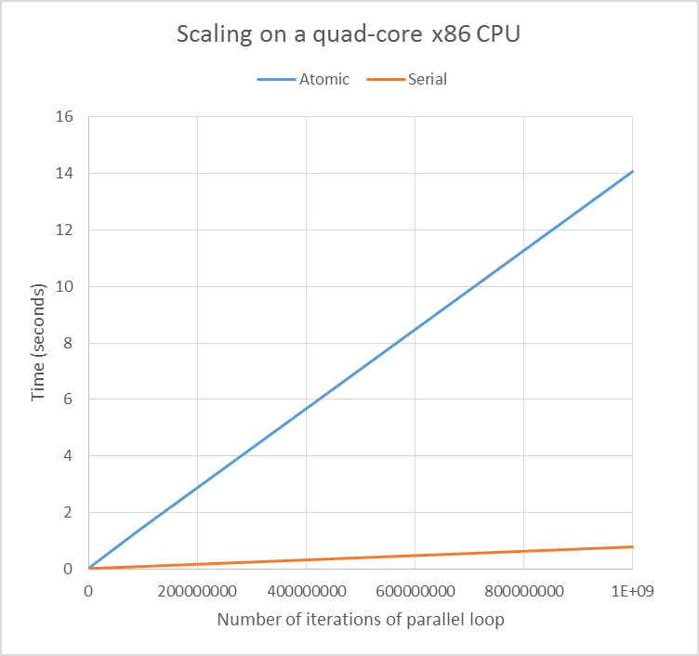
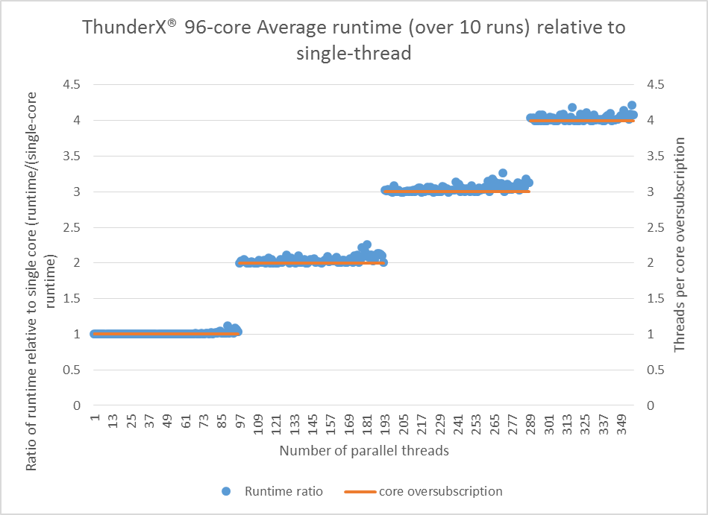
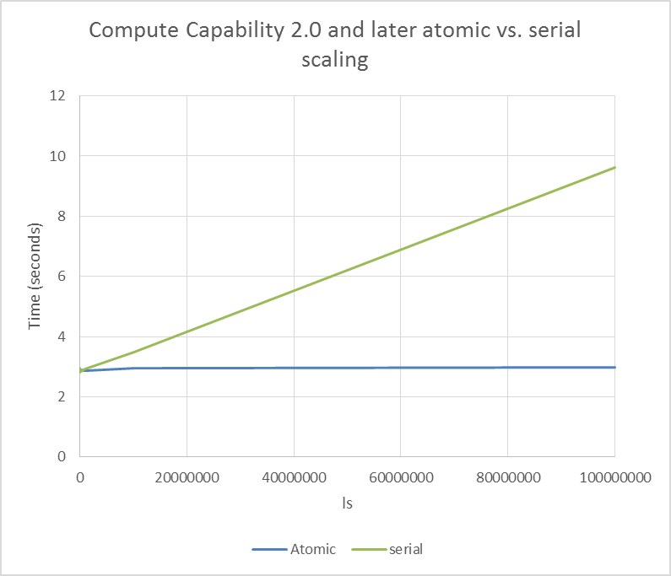
Chapter 1: Speedups, Scaling, and Resource Usage
Controlling Parallel Resources: A Parallel Random Number Generator showing OpenACC task-based parallelism
Most parallel programmers use Thread Level Parallelism (TLP) to exploit the greatest amount of parallelism in the system and achieve high performance.
Instruction level parallelism (ILP) can be equally effective in hiding thread latency by keeping the processor (or GPU) busy with fewer threads that consume fewer resources and introduce less overhead.
Speedup over single-thread on 96-core Cavium ThunderX® system

Slide 5

Chapter 2: Profile-Guided Development with OpenACC
Jeff Larkin (NVIDIA Corp, USA)

Slide 6
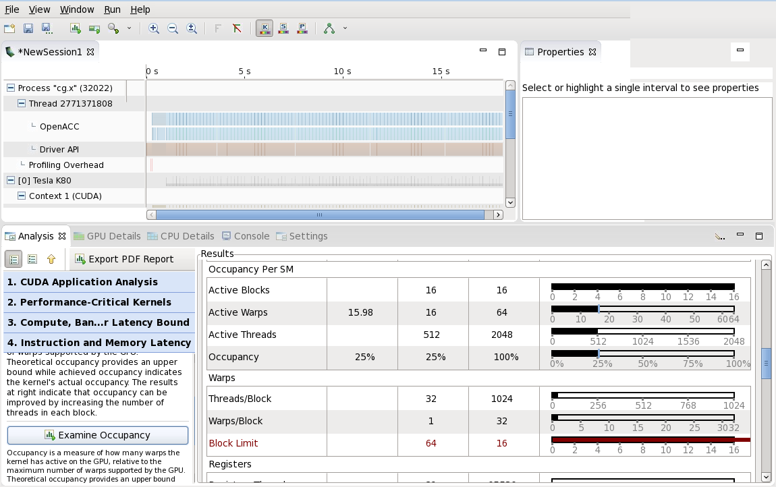
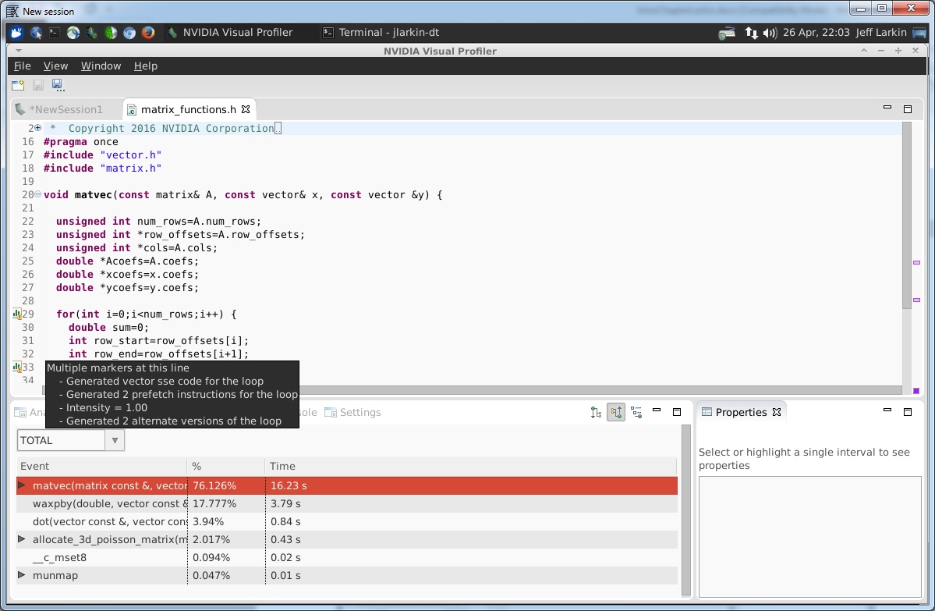
Chapter 2: Provide a basic understanding
The OpenACC kernels directive
OpenACC data directives and clauses
The PGProf profiler
OpenACC’s 3 levels of parallelism
Data dependencies
PGProf profiler showing low GPU occupancy
PGProf profiler displaying compiler feedback information about an important loop

Slide 7
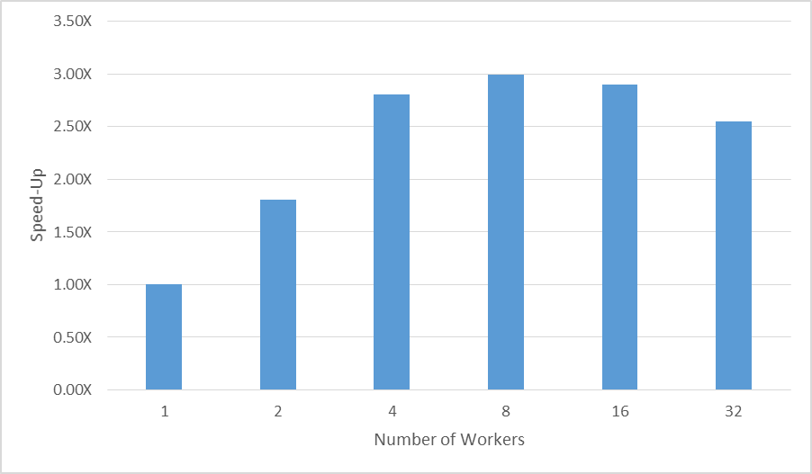
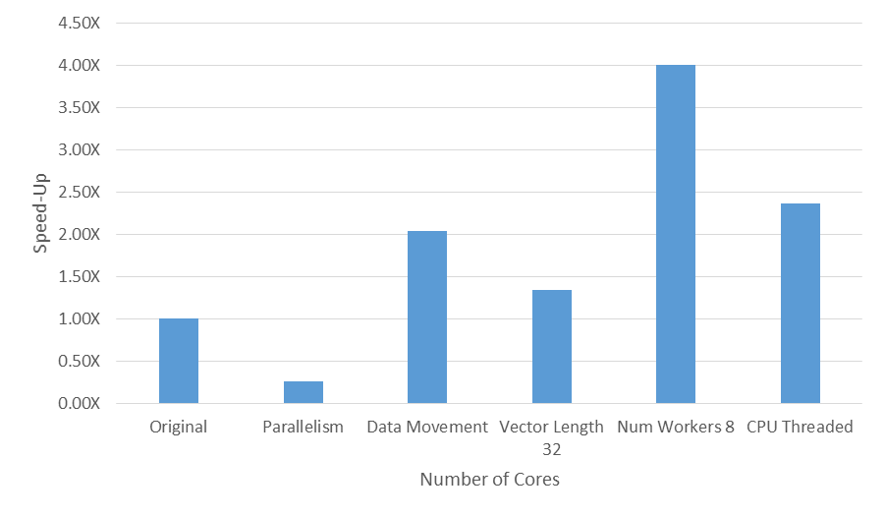
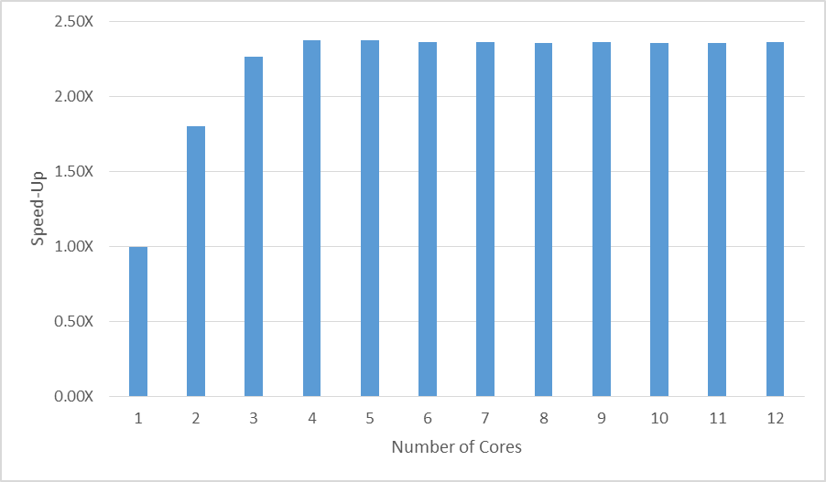
Chapter 2: Speedups
Speed-up from increasing the number of workers
Final performance results for each step
Performance improvement from multicore acceleration.

Slide 8


Chapter 3: Profiling Performance of Hybrid Applications with Score-P and Vampir
Guido Jukeland (Helmholtz-Zentrum Dresden-Rossendorf (HZDR), Germany)
Robert Dietrich (Technische Universität Dresden, Germany)

Slide 9
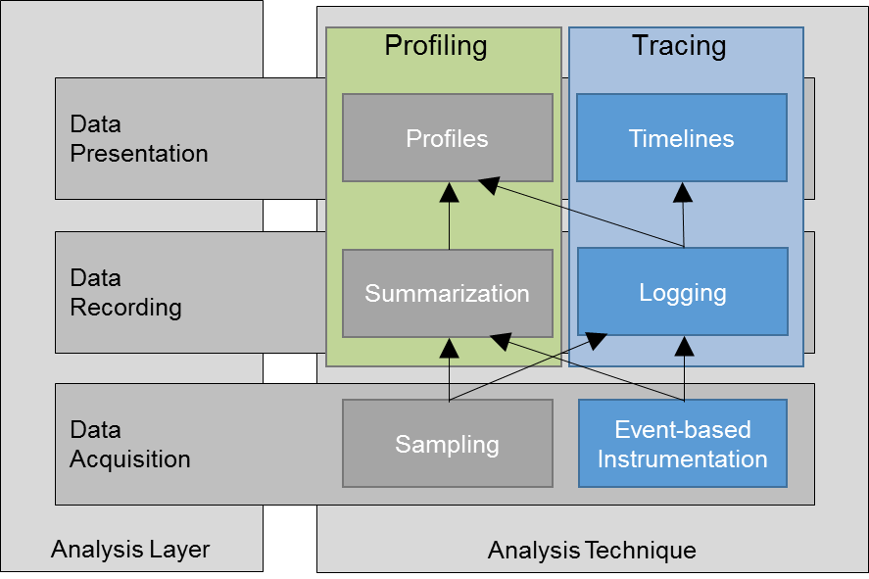
Chapter 3: Provide a basic understanding
Terminology and methods for performance analysis of hybrid applications (e.g. MPI + OpenACC)
How to modify hybrid applications to generate and record performance data
How to visualize and analyze the performance data to make educated choices on application improvement
Common pitfalls when extending an existing parallel application to include another parallelization paradigm
Formal categorization of performance analysis techniques and their relationships

Slide 10
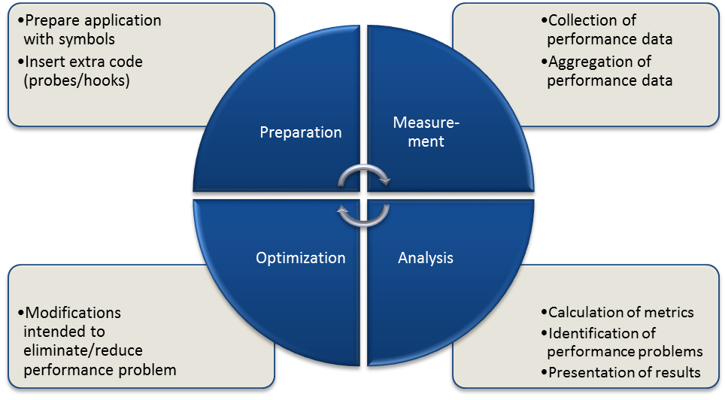
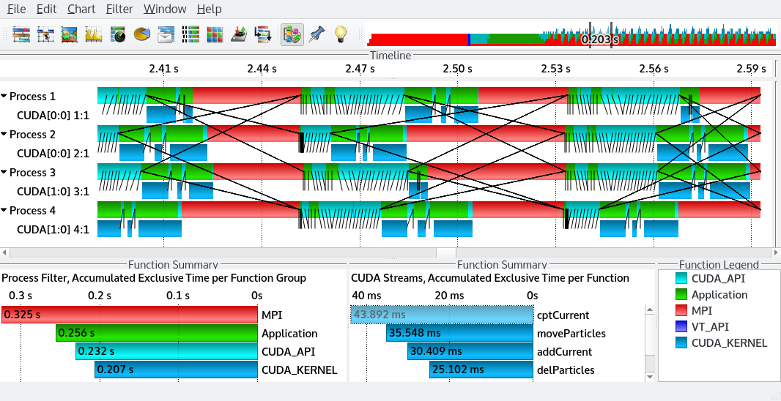
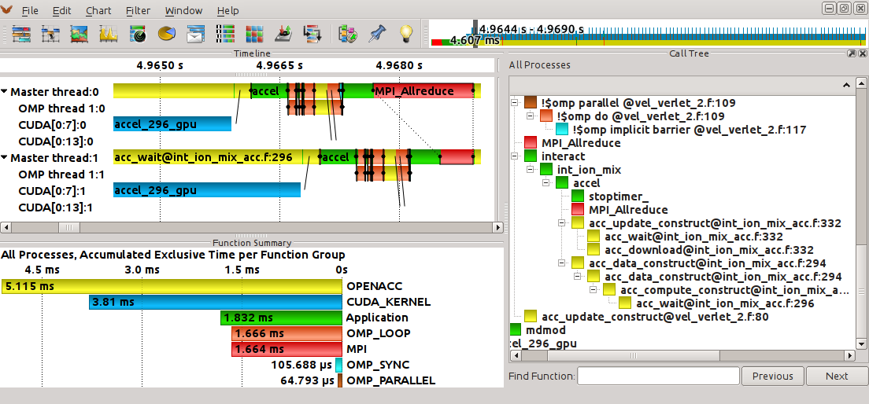
Chapter 3: Profiling
The evolutionary application performance improvement cycle
Vampir displaying the trace of a first naive MPI parallelization
OpenACC runtime events and accelerator activities

Slide 11
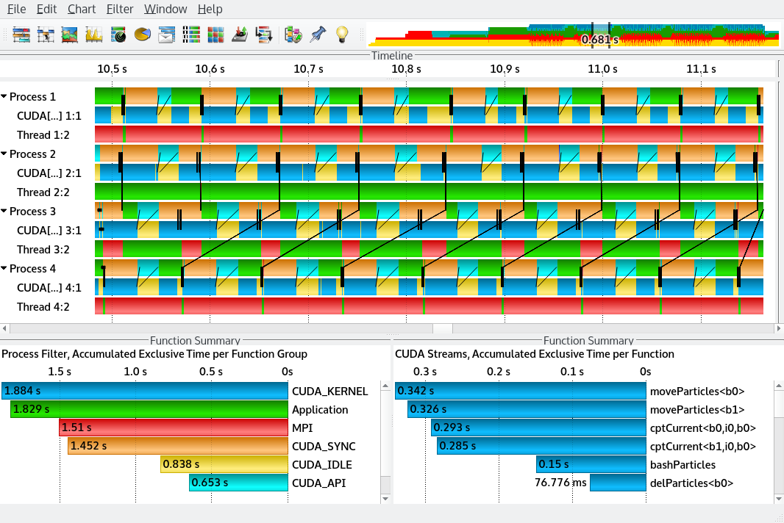
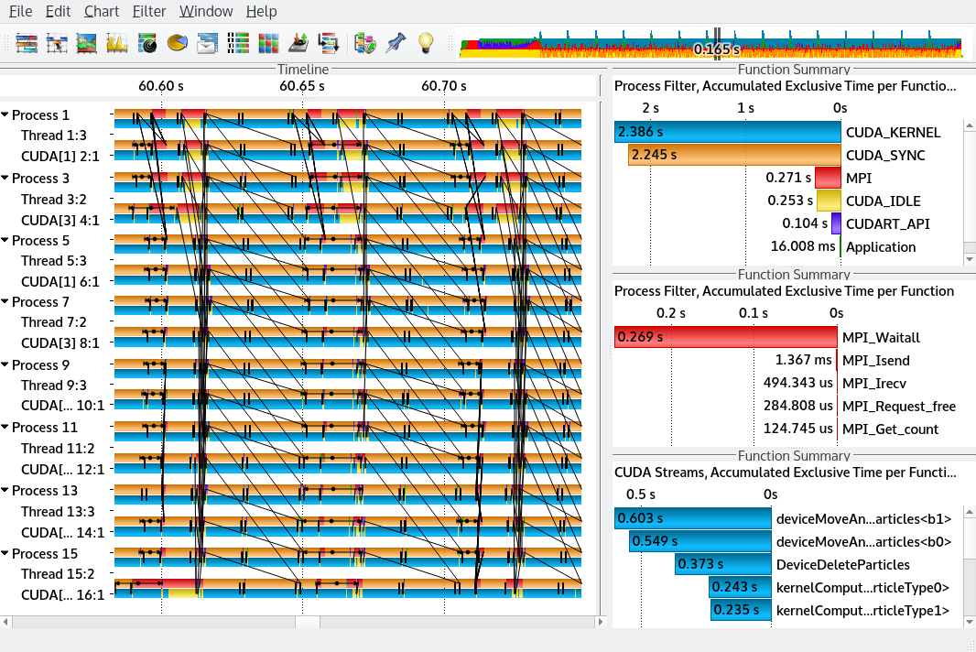
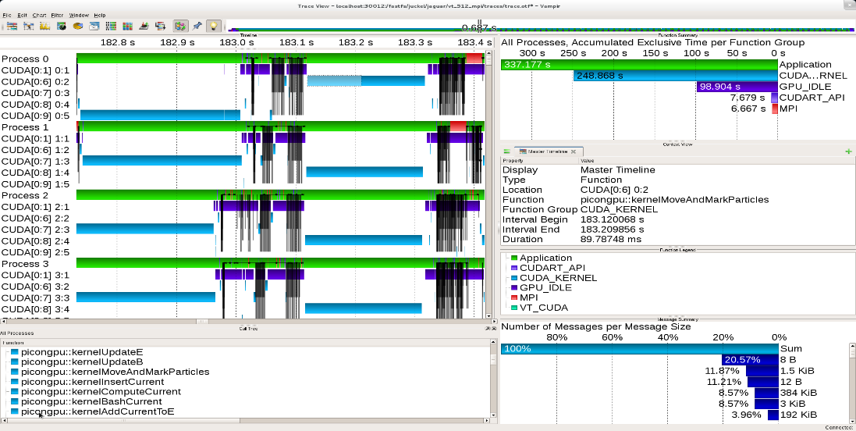
Chapter 3: MPI Profiling
Vampir trace of a first naive MPI parallelization
A first improved version
Using optimized data structures and async MPI
Running at large scale on 512 nodes

Slide 12
Chapter 4: Pipelining Data Transfers with OpenACC
Jeff Larkin (NVIDIA Corp, USA)

Slide 13

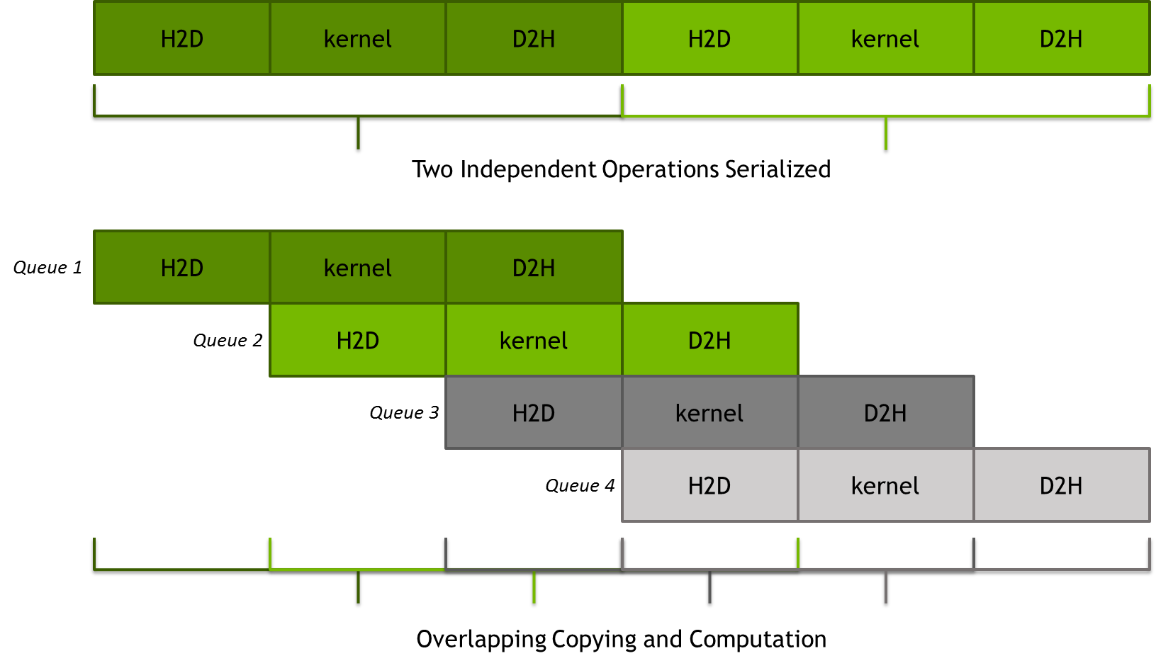
Chapter 4: Provide a basic understanding
Asynchronous execution within OpenACC
Pipelining as a technique to overlap data transfers with computation
How to use the OpenACC routine directive
Sample Mandelbrot set image

Slide 14
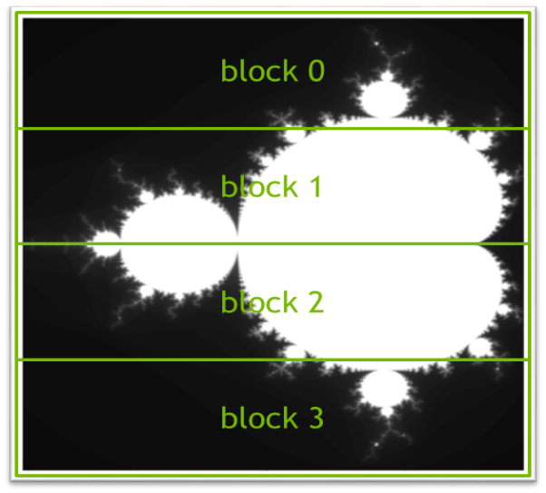
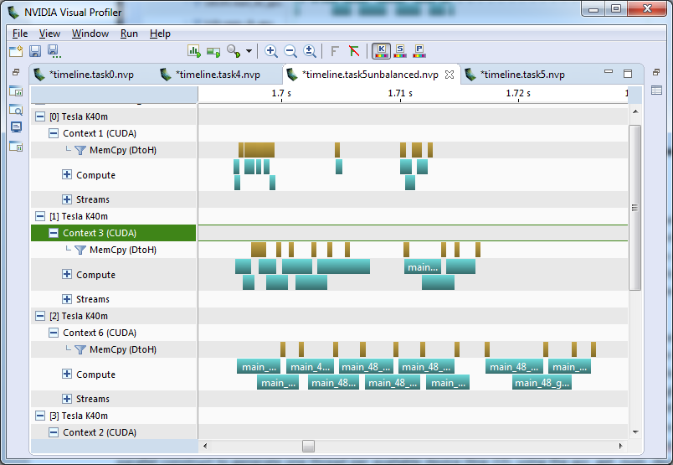
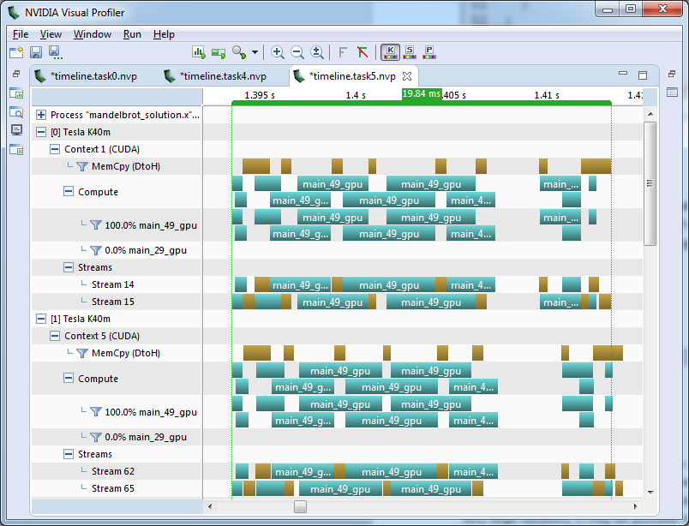
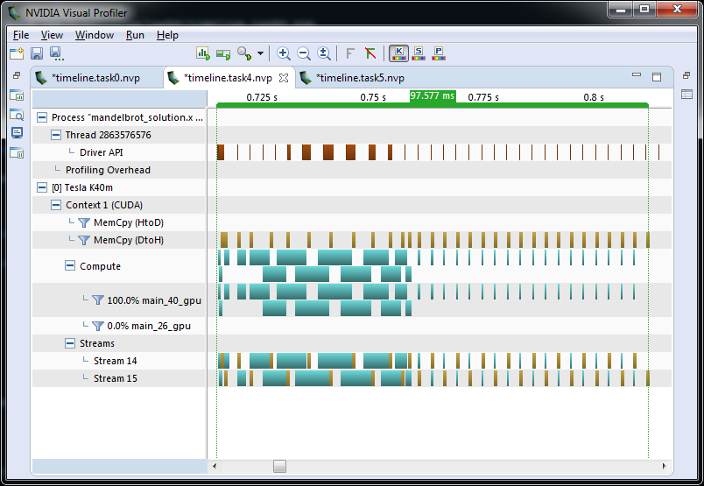
Chapter 4: Pipelining and Multi-GPU
Mandelbrot image broken into 4 blocks
NVVP timeline for unbalanced multi-GPU
NVVP timeline for pipelined code
NVVP timeline for multi-GPU code

Slide 15

Chapter 5: Advanced Data Management
Mathew Colgrove (The Portland Group, USA)

Slide 16
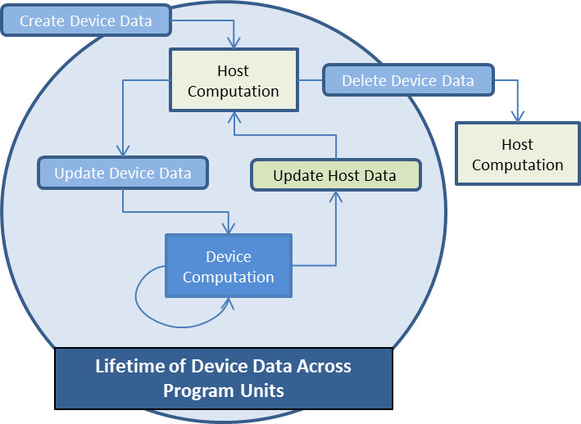
Chapter 5: Provide a basic understanding
Unstructured data regions
Working with aggregate types with dynamic data members
C++ class data management
Using global static and Fortran module variables in device routines
How to create device only data
Sharing device memory between MPI processes
A wide range of topics
Unstructured data regions
Aggregate types with dynamic data members
C++ class data management
A generic list container class
accList update methods
Using global and module variables in routines
Using device only data
Mapping device data
Sharing device memory between MPI processes

Slide 17
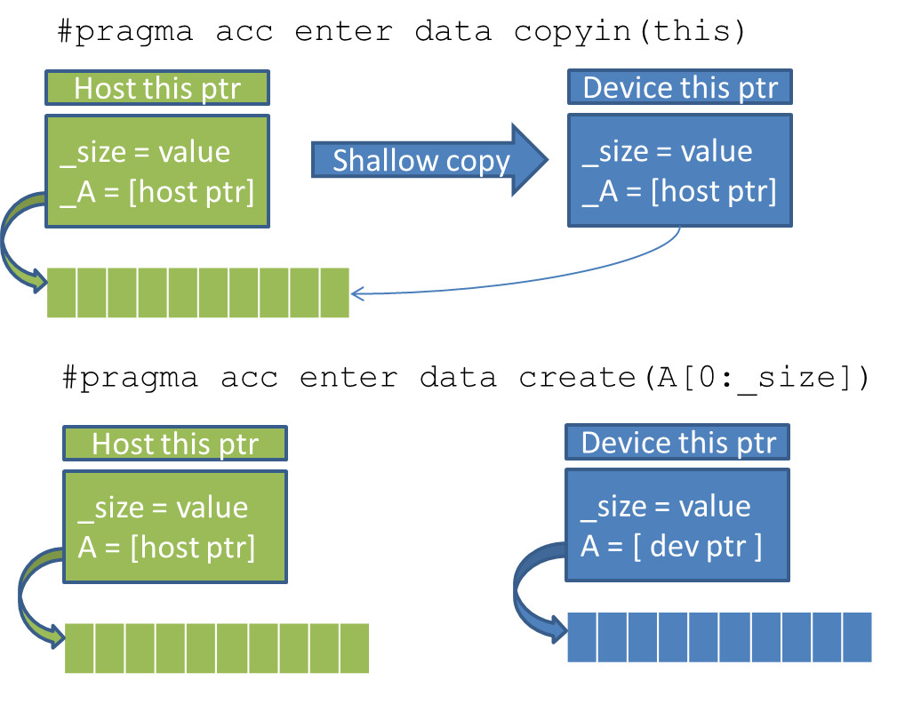
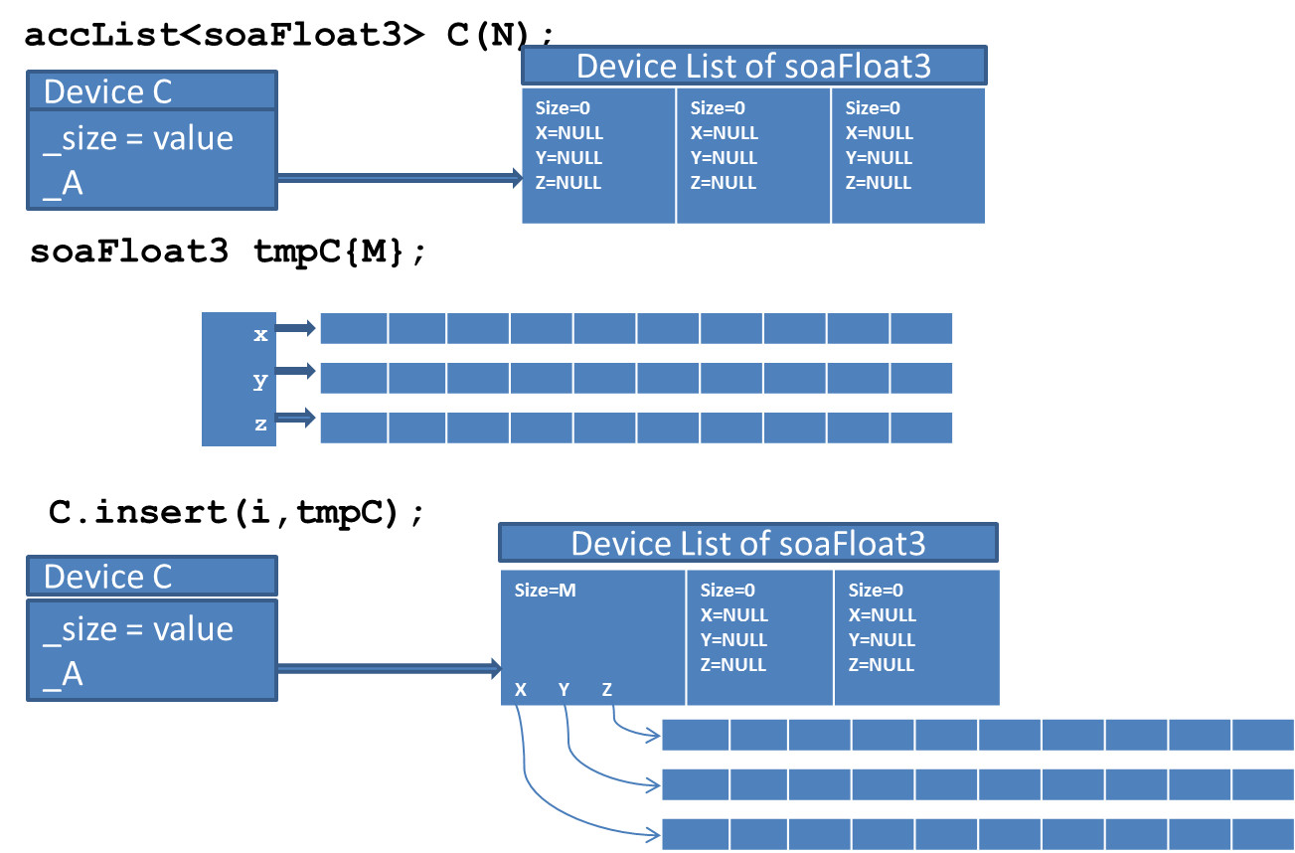
Chapter 5: Many code examples
Creating Device Data in a C++ Constructor
Inserting a soaFloat3 into accList

Slide 18
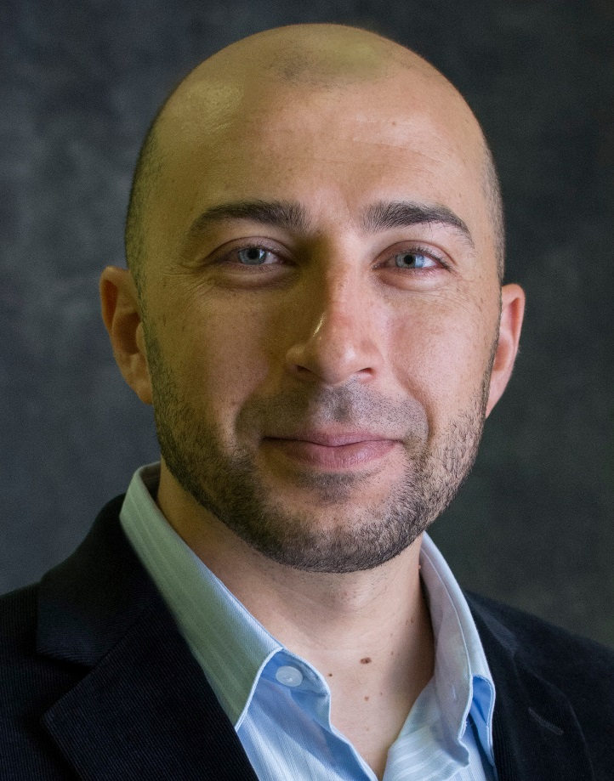

Chapter 6: Tuning OpenACC Loop Execution
Saber Feki (King Abdullah University of Science and Technology, Saudi Arabia)
Malek Smaoui (King Abdullah University of Science and Technology, Saudi Arabia)

Slide 19
Chapter 6: Provide a basic understanding
Have a better understanding of the purpose of the OpenACC loop construct and its associated clauses illustrated with use cases, and
Use the acquired knowledge in practice to further improve the performance of OpenACC accelerated codes.
Basic loop optimization clauses
The auto clause
The independent clause
The seq clause
The reduction clause
The collapse clause
Advanced loop optimization clauses
The gang, worker, and vector clauses
The tile clause
31 #pragma acc data copyin(a,b) copy(c)
32 #pragma acc kernels
33 #pragma acc loop auto
34 for (i = 0; i < SIZE; ++i) {
35 #pragma acc loop auto
36 for (j = 0; j < SIZE; ++j) {
37 #pragma acc loop auto
38 for (k = 0; k < SIZE; ++k) {
39 c[i][j] += a[i][k] * b[k][j];
40 }
41 }
42 }

Slide 20
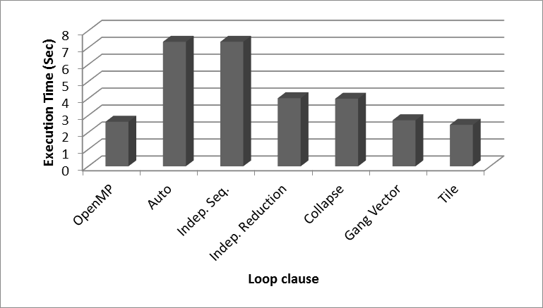
Chapter 6: Tuning

Slide 21

Chapter 7: Multi Device Programming with OpenACC
Jiri Kraus (NVIDIA GmbH, Germany)

Slide 22
Chapter 7: Provide a basic understanding
How to program multi-device systems or accelerated clusters with OpenACC using a single host thread, OpenMP or MPI.
Coordinate the work of multiple devices using a domain decomposition strategy.
How to use the async clause to overlap computation and MPI communication.
How to use the NVIDIA® tools for MPI+OpenACC applications.
The two major reasons to use multiple Devices are:
Compute faster – More devices equals faster time to solution
Compute larger – More devices equals more memory for larger problems

Slide 23
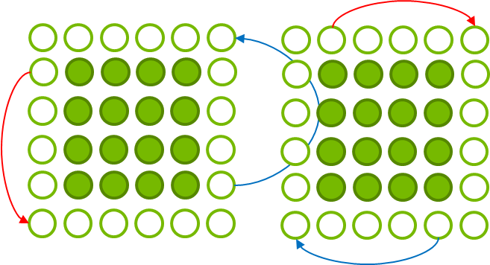
Chapter 7: Boundaries and domain decomposition
Apply periodic boundary conditions
Domain Decomposition strategies
A halo exchange

Slide 24
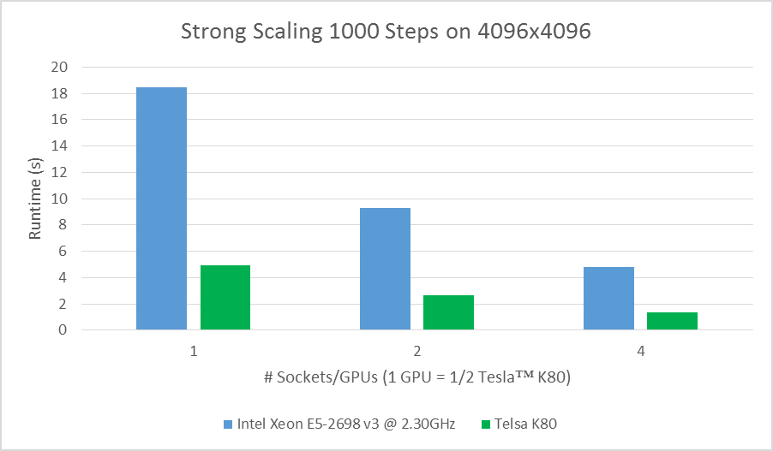
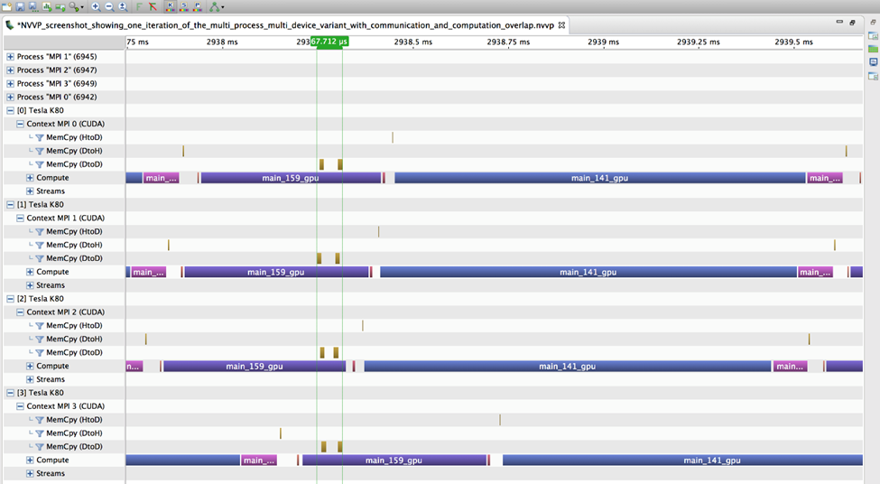
Chapter 7: Communications hiding and performance
Illustration of MPI communication time hiding
NVVP screenshot showing multi-device with MPI and computation overlap

Slide 25

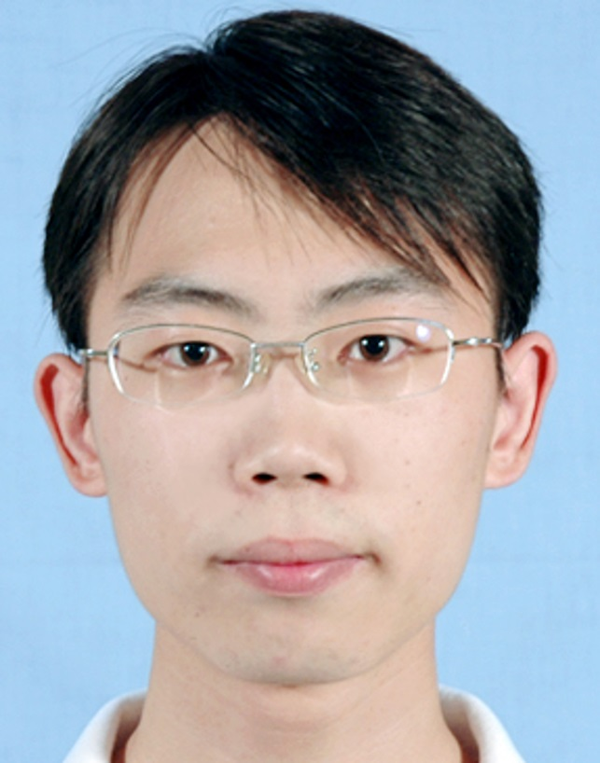

Chapter 8: Using OpenACC for Stencil and Feldkamp Algorithms
Sunita Chandrasekaran (University of Delaware, USA)
Dr. Rengan Xu (University of Houston, USA)
Barbara Chapman (Stony Brook University, USA

Slide 26
Chapter 8: Provide a basic understanding
How to profile and gain a basic understanding of code characteristics for GPUs
How to compile an OpenACC code using relevant compilation flags and analyse the compilation information
How to incrementally improve an OpenACC code
How to use OpenMP with OpenACC in the same code
How to tune OpenACC code and provide relevant hints to achieve close to, or better performance than CUDA code
Two Use cases:
The Feldkamp-Davis-Kress (FDK) Algorithm used as part of the workflow to reconstruct CT (Computed Tomography) images in medicine
The 2D Heat Equation
Initialization;
foreach 2D image in detected images do
foreach pixel in image do
Pre-weight and ramp-filter the projection;
end
end
foreach 2D image in detected images do
foreach voxel in 3D reconstruct volume do
calculate projected coordinate;
sum the contribution to the object from all tilted fan beams;
end
end
FDK pseudo code

Slide 27
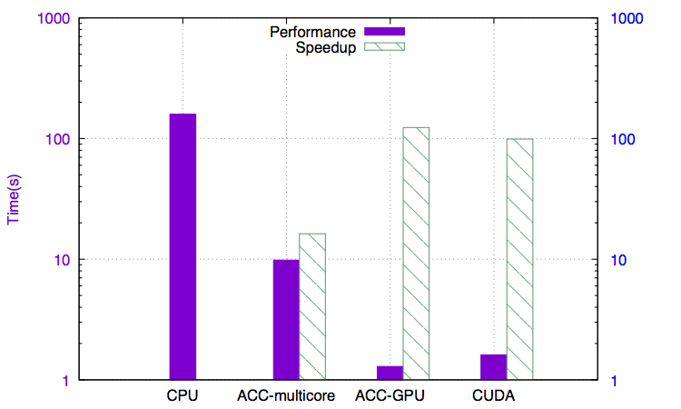
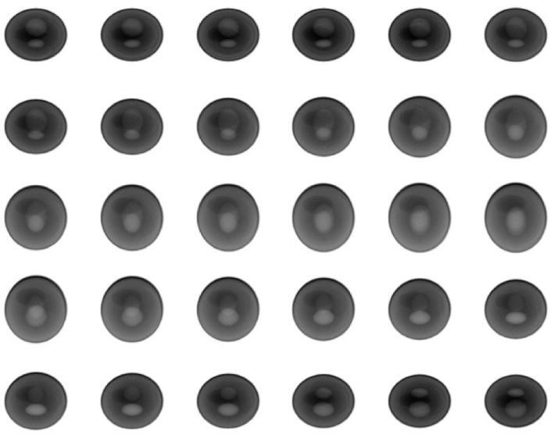
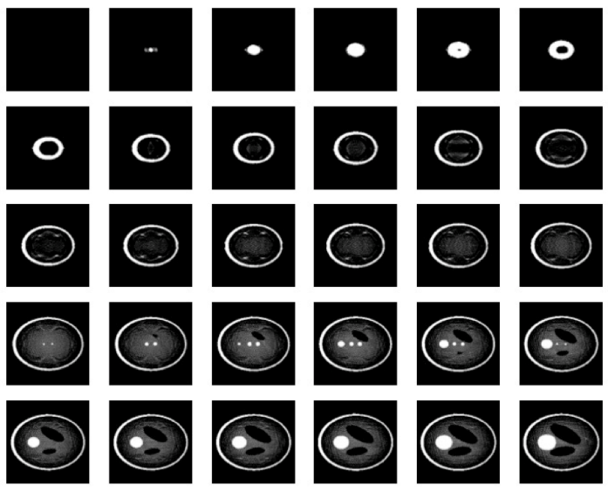
Chapter 8: FDK
2D input image slices
2D output image slices

Slide 28
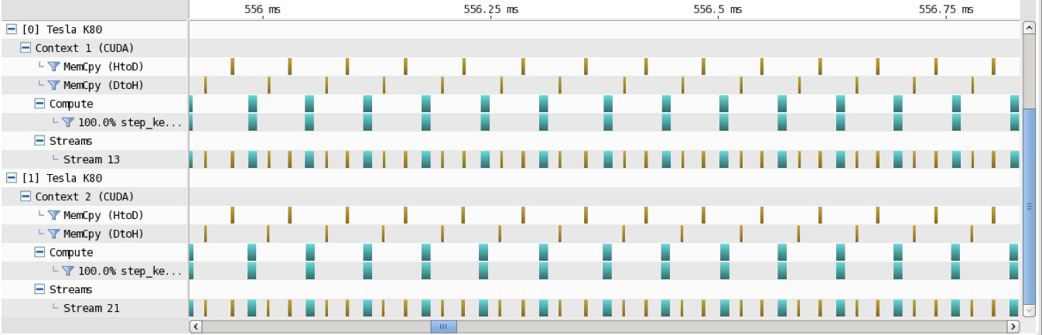
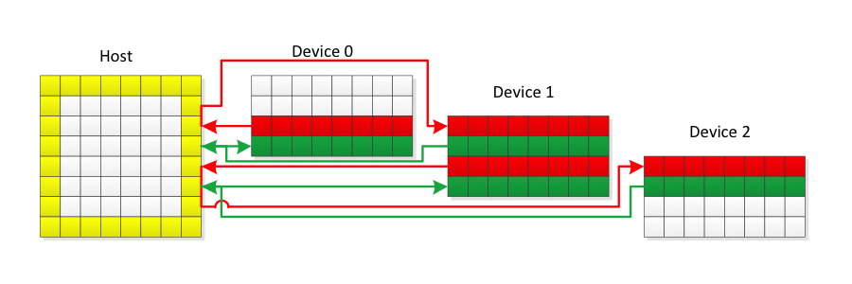
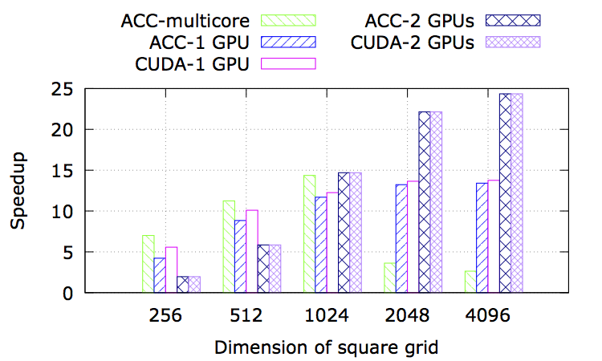
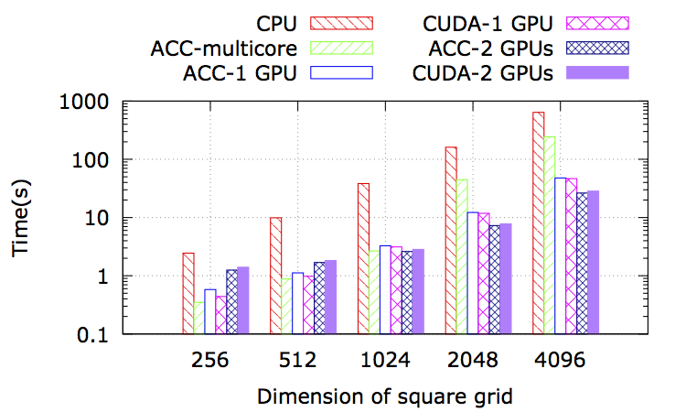
Chapter 8: 2D Heat Equation
Profiling result for multi-GPU implementation
Data movement in multi-GPU implementation
Performance using different models
Speedup relative to CPU

Slide 29

Chapter 9: Accelerating 3D Wave Equations using OpenACC
Ty McKercher (NVIDIA Corp, USA)

Slide 30
Chapter 9: Provide a basic understanding
A finite difference code
How to convert OpenMP code to OpenACC
Practical techniques to profile and analyze performance behavior of finite difference codes
How to use Unified Memory with OpenACC
Testing portability targets including multicore systems
To maximize your productivity, the OpenACC tools help you:
Highlight parallel execution dependencies
Identify critical optimization targets
Measure code intensity regions (comparing memory bandwidth vs floating point operations)

Slide 31
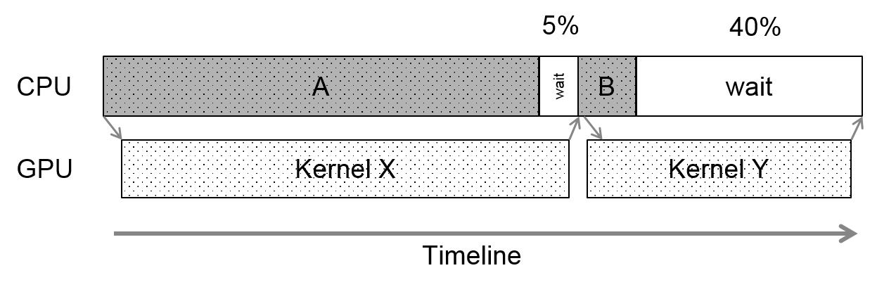
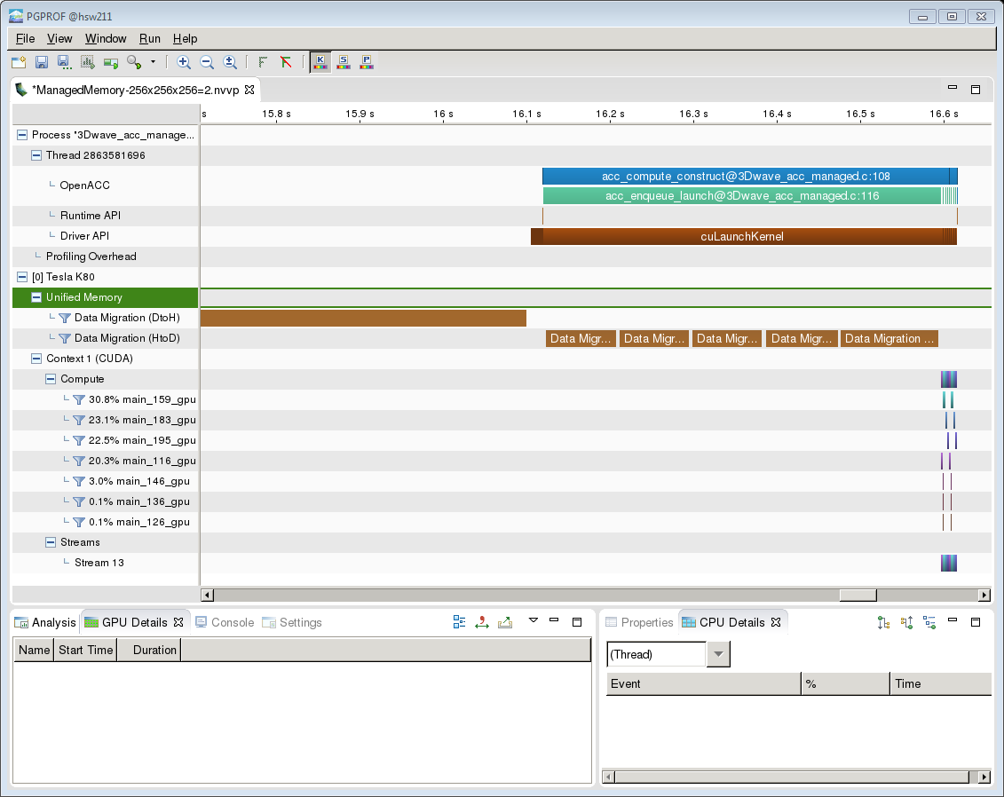
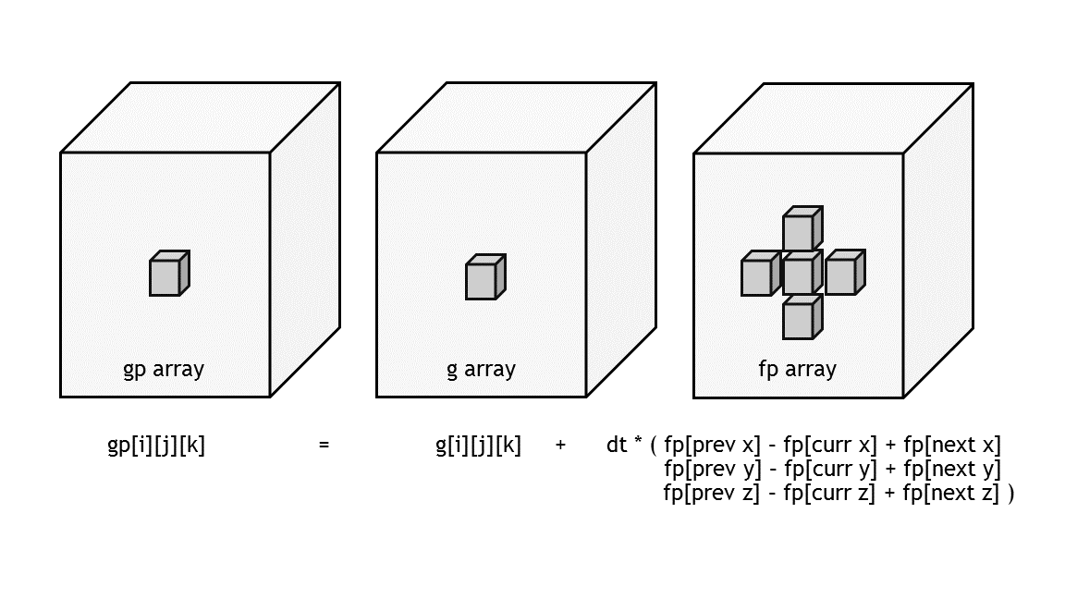
Chapter 9: Identify kernels with most impact
Reducing Kernel Y runtime will have the most performance impact since that will reduce overall wait time.
pgprof showing Unified Memory data migration.
A stencil pattern is used to add contributions from neighboring elements when solving a 3D wave equation

Slide 32

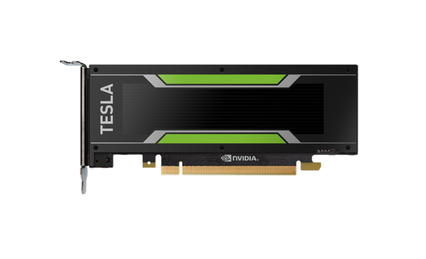
Chapter 9: GPU&CPU, OpenMP vs OpenACC, Scalability and Managed memory
Scalability results using OpenMP on x86
OpenACC targeting Haswell multicore CPU
OpenACC data directives on Tesla M40 GPU
Scalability results using OpenMP on Tesla M40

Slide 33
Chapter 10: The Detailed Development of an OpenACC Application
Andy Herdman (AWE plc., United Kingdom)
Wayne Gaudin (AWE plc., United Kingdom)
Oliver Perks (AWE plc., United Kingdom)

Slide 34
Chapter 10: Provide a basic understanding
A range of optimisations based on how each compute kernel is utilising the GPU’s threads.
The creation of a robust, optimal fully resident OpenACC code.
Extension of the code to use multiple GPUs by developing a hybrid MPI/OpenACC implementation
Analysing why the GPU code ran faster than a single CPU core, but showed detrimental performance compared to an entire CPU socket.
How to examine a code to eliminate inner loop dependencies, refactor nested loops, and eliminate serial execution, unnecessary memory allocations, and hidden data transfers.
The use of asynchronous data transfers.
In the end achieve:
Overall GPU performance gains realised a 19.34x speedup over a single Interlagos CPU core, and a factor of 4.91 over an entire socket.
Overall CPU performance increase from 652 MFLOP to more than 1 GFLOP.
Approximate 50% increase in strong scaling.
Greater than 96% increase in weak scaling.

Slide 35
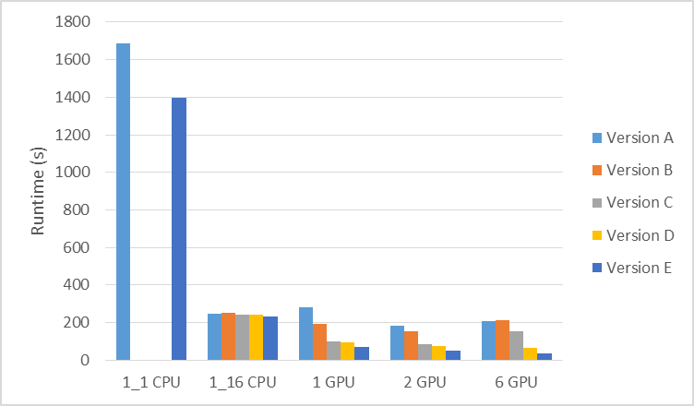
Chapter 10: Impact of five optimizations plus scalability across GPUs
20
15
ScalingRelative1GPU
10
5
0
0
5
10
15
20
25
30
35
No. GPUs
Multi-GPU Scalability

Slide 36

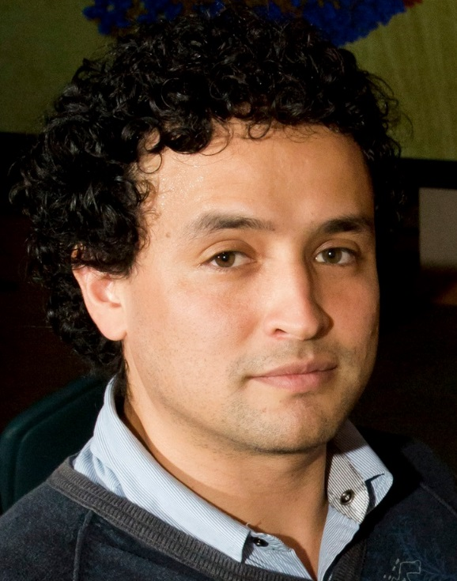


Chapter 11: GPU-Accelerated Molecular Dynamics Clustering Analysis with OpenACC
John E. Stone (University of Illinois at Urbana-Champaign, USA)
Juan R. Perilla (University of Illinois at Urbana-Champaign, USA
C. Keith Cassidy (University of Illinois at Urbana-Champaign, USA)
Klaus Schulten (University of Illinois at Urbana-Champaign, USA)

Slide 37
Chapter 11: Provide a basic understanding
• Differences in development and maintenance of directive-based kernels and compiler autovectorization as compared with data-parallel languages such as CUDA and OpenCL, and hand-written kernels based on compiler intrinsics and the like.
• The step-by-step approaches taken for adaptation of an existing molecular dynamics trajectory analysis algorithm for OpenACC.
• Program and data structure transformations that are beneficial for performance on GPU accelerators and many-core CPUs that employ wide SIMD vector arithmetic units.
• Performance tuning techniques that can help OpenACC compilers and runtime systems achieve better performance on target accelerators with typical architecture characteristics.

Slide 38
Chapter 11:
Fast Computation of Pairwise RMSDs with QCP
Good for visualization
Represents unnecessary work when computing the RMSD dissimilarity matrix for clustering analysis
Use Theobald’s Quaternion Characteristic Polynomial (QCP) method
Algorithm 2 Calculate RMSD dissimilarity matrix for an entire MD trajectory.
1: for i = 1 to N do {loop over trajectory frames}
2: Convert sparse atom selection for each frame to compact SOA coordinate array
3: Compute center of mass from in-register coordinates values
4: end for
5: for i = 1 to N do {loop over trajectory frames}
6: Translate each frame so that the center of mass lies at the origin
7: end for
8: for j = 1 to N do {loop over trajectory frames}
9: for i = 1 to j do {loop over trajectory frames}
10: for l = 1 to S do {loop over selected atoms}
11: Sum QCP adjoint matrix components A and E0
12: end for
13: Perform Newton-Raphson iteration to solve RMSD from A and E0
14: RMSDij ( RMSD
15: end for
16: end for
17: return RMSDij
Schematic of underlying molecular free-energy landscape sampled by an MD simulation.
Molecules transition back and forth, as signified by
black arrows, between local low-energy basins along a reaction coordinate.
Solid circles denote the representative conformations of each energetic basin.

Slide 39
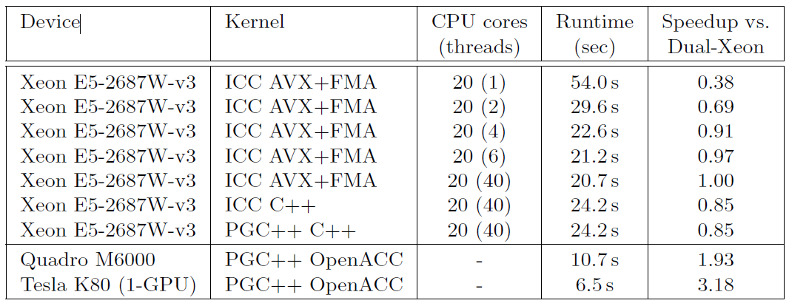
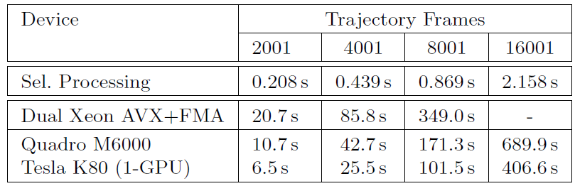
Chapter 11:
Execution times are reported for atom selection processing (compaction and padding of sparse selections, AOS to SOA conversion, and center-of-mass translation preprocessing steps), and OpenACC dissimilarity matrix kernels on multiple targets for varying MD trajectory sizes (the side
length of the dissimilarity matrix).
Comparison of CPU and OpenACC-based GPU-accelerated kernel performance.
Kernel timing results include all host-GPU memory transfers and kernel launches required for evaluation of one triangle of a 2001 × 2001 dissimilarity matrix, for a trajectory with 20,000 selected atoms.
All speedups are computed relative to the fastest hand-coded AVX and FMA based kernel.
The performance data for the Xeon CPU runs using the kernel based on hand coded AVX and FMA intrinsics demonstrates that the CPU performance is memory-bandwidth-bound even when using a small fraction of the CPU cores.
The Tesla K80 result shown used only one of the two GPUs contained on the board.

Slide 40

Chapter 12: Incrementally Accelerating the RI-MP2 Correlated Method of Electronic Structure Theory Using OpenACC Compiler Directives
Janus Juul Eriksen (Johannes Gutenberg Universität Mainz, Germany)

Slide 41
Chapter 12: Provide a basic understanding
The purpose of this chapter is to demonstrate how electronic structure many-body theories may be incrementally accelerated in an efficient and portable manner by means of OpenACC compiler directives, with an illustrative application to the RI-MP2 method. The efficiency of the implementation (using six K40 GPUs) is illustrated through a series of test calculations, for which the accelerated code is capable of reducing the total time-to-solution by at least an order of magnitude over an optimized CPU-only reference implementation.
At the end of this chapter the reader will have an understanding of:
The Use of Accelerator Offloading in Quantum Chemistry
Asynchronous Pipelining of Computations and Data Transfers
Hybrid CPU/GPU Computing Using OpenMP Compiler Directives
Fortran Interoperability with CUBLAS
Pinning of Memory in CUDA Fortran

Slide 42
Chapter 12:
Total time-to-solution for the CPU-only and hybrid CPU/GPU versions of schemes 7 and 8 (using six K40 GPUs).

Slide 43



Chapter 13: Using OpenACC to Port Large Legacy Climate and Weather Modelling Code to GPUs
Xavier Lapillonne (MeteoSwiss, Switzerland)
Katherine Osterried (MeteoSwiss, Switzerland)
Oliver Fuhrer (MeteoSwiss, Switzerland)

Slide 44
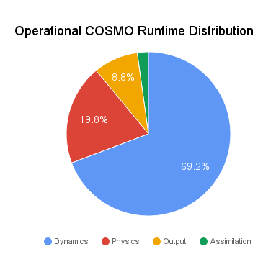
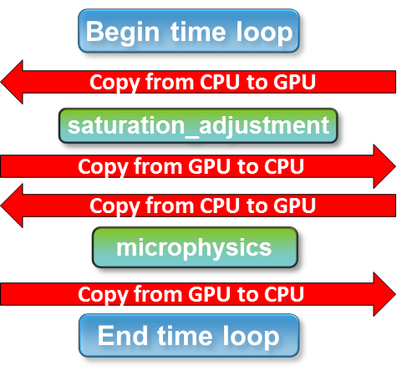
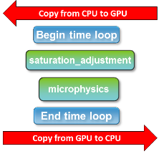
Chapter 13: Provide a basic understanding
How to use OpenACC to port components of a production weather and climate model achieving a gain of about a factor 2.3x in terms of time to solution and about a factor 3x in terms of energy to solution
The step-by-step approach to port large sections weather and climate model code with OpenACC
Optimizations that may be introduced to further enhance performance on GPU when using OpenACC
COSMO runtime distribution
Before
After
Optimizing data transfers before and after step 2

Slide 45

Chapter 13: Various optimizations
Advanced optimizations
Loop fusion and re-ordering
Scalar replacement
Caching
On-the-fly computation
Basic optimizations
Fine-grain control of parallelism
Porting the output / Reductions
Removal of automatic arrays
Run | Duration of time loop (PGI) | Duration of time loop (Cray)
Step 1: Add parallel regions | 1406 ms | 1014 ms
Step 2: Managing data transfers | 87 ms | 82 ms
Step 3: Basic optimizations | 72 ms | 61 ms
Alternate code 1 (acc routine) | 76 ms | 99 ms
Alternate code 2 (CUDA) | 58 ms | 61 ms
COSMO radiation timing for a 128x128x60 domain using the Cray and PGI compiler. CPU: 12-core Intel Xeon E5-2690 v3 (Haswell) , GPU: Nvidia Tesla K80 card.
Runtimes

